Slide 1




Design Patterns
Java Project

Slide 2
Content
Problem Statement: Demonstrate implementation of key object-oriented design patterns in Java
Target User: Students learning software design and OOP concepts
Presented by: Ahona Sarkar (CSE IoT, 2nd Year)

Slide 3
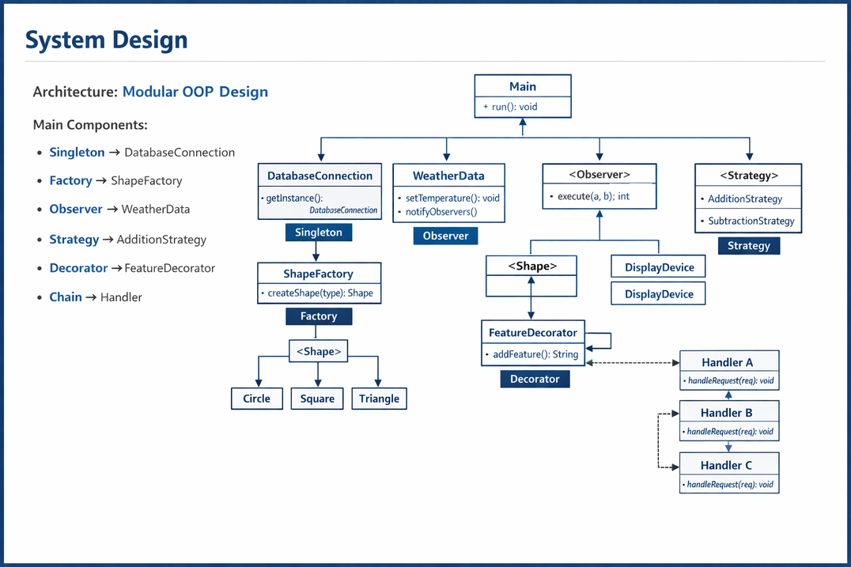
System Design
Content:
Architecture: Modular design using multiple design patterns
Key Classes: DatabaseConnection (Singleton)
DatabaseConnection (Singleton)
ShapeFactory (Factory)
WeatherData (Observer)
FeatureDecorator (Decorator)
Package Structure:singleton
singleton
factory
observer
decorator
strategy
chain

Slide 4
OOP Concepts Used
Content:
Abstraction: Interfaces (Shape, Observer, Strategy)
Inheritance: Classes implement interfaces
Polymorphism: Method calls resolved at runtime
Design Patterns Used:
Singleton
Factory
Observer
Decorator
Strategy
Chain of Responsibility

Slide 5

Technical Highlight
Content:
Factory Pattern for Object Creation
Dynamically creates objects based on user input
Avoids large if-else or switch conditions
Why chosen:
Improves scalability
Easy to extend (added Triangle without changing existing code)

Slide 6
Live Demo
Content:
Run Main.java
Show:
Shape creation (Factory)
Observer notification (temperature update)
Decorator adding extra feature
Error Handling:
Invalid shape → returns null
Chain → "Not handled" case

Slide 7
Thank You

